Slide 1

Q1 –Task1
Business Analyst - Case & Behavioural Interview – Franco Fan
What are the various interactions (for the borrower and for the lender) and key characteristics of the portal that you think will be necessary to facilitate a good experience?
To answer this question, my approach is to:
Think from both perspective (draft idea)
Question the business (market research, competitive analysis)
Draft requirement (solution outline)
Define solution structure (construct solution components)
Picture ideal product (product mapping & final touch)

Slide 2
Role in Lending business
Define roles within simplified workflow
Borrower (And potential clients)
Loan Operator
(Case operations includes customer servicing, technical support roles)
Loan Approver
(Evaluating cases, assessing creditworthiness,
analyzing financial documents, loan approval decision maker)
External Service Provider
(External partners for completing the workflow, such as
ID verification solution vendor, Credit Reporting Agencies)

Slide 3
Borrower perspective, portal requirement:
Expectation and rationale: (Assume no priority in orders)
List top 10 wishes and rationale as client
Anytime everywhere - Accessible by their own device and easy to use by everybody
Efficient - Workflow process are efficient, Simple user interface
Predictable - Ability to predict loan schedule, repayment information before application
Secured - Capable in information protection
Accessibility - Round-the-clock accessibility
Informative - Ability to provide detailed loan information and deliver notification
Customized service - Adaptability for customized user experience (e.g. notification channel, payment method)
Progress update - Ability for real-time update
Payment reminder - Reliable in scheduled reminder to avoid penalties
Device friendly - Accessibility for any devices (e.g. Mobile, Windows/ Mac, IPad)

Slide 4
Lender perspective, portal requirement:
Expectation and rationale: (Assume no priority in orders)
List top 10 wishes and rationale as business owner
Compliance - Adaptability for regulatory standards to avoid operational risk (fines, license cancellation)
Standardize - Universal workflow design for diverse products
Business Intelligence - Capability in business analytics (client value, operational KPIs, product trend)
Easy-to-use - Accessible for everybody
Authorization - Ability in setting customized authorization level between users to facilitate business use cases
Automation - Ability in automated risk monitoring, KPIs tracking, notifications
Exceptional handling – Adaptability in manual intervention
Secured - Reliability in information protection
Communication - Ability to facilitate users communication
Editable - Flexibility to facilitate adjustment in product information, client profiles, promotion materials

Slide 5
Q1Task1 Various interactions (for both borrower and lender) and key characteristics of portal to facilitate good experience
Various interactions:
Anytime everywhere
Efficient
Predictable
Secured
High availability
Informative
Customized service
Progress update
Reminder for payment
Device friendly
Key Characteristics:
Reliable, high availability system architecture
User-friendly interface, efficient workflow design
Progress bar to show application status
Secured in information protection
Business analytic service for borrower and lender
Payment reminder
Responsive web application
Adaptability in regulatory adjustment
Universal design to fit 3 types of loan product
Ability for different user authorization level
Process automation for enhanced efficiency
Manual intervention possibility
Chat functions between users
Compliance
Standardize
Business Intelligence
Easy-to-use
Authorization
Automation
Exceptional capability
Secured
Communication
Editable
*Revisit to the list after completion of workflow/ use case diagram to ensure every essential characteristics are captured.
(added after diagram is completed): Database Recovery, Connectivity to external vendor (these are crucial for operation efficiency, should be count into Key Characteristics)

Slide 6
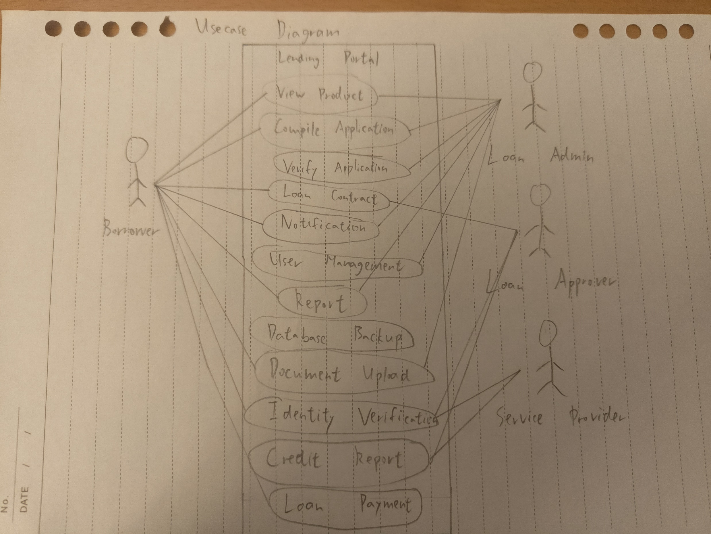
Functional Use Case Diagram
Borrower
view product
compile application
loan contract
loan payment
notification
report
document upload
Loan admin
view product
compile application
verify application
loan payment
notification
report
user management
document upload
Loan approver
loan contract
identity verification
credit report
Service Provider
Identity verification
Credit report
Remarks: 3 main roles in loan processing (simplified)
Loan admin involves in case processing excluding approval.
Loan approver acts as independent risk gatekeeper, focusing on Loan decisioning.
Service Provider (external vendor) facilitating the workflow (Electronic ID verification/ Credit rating service provider)

Slide 7
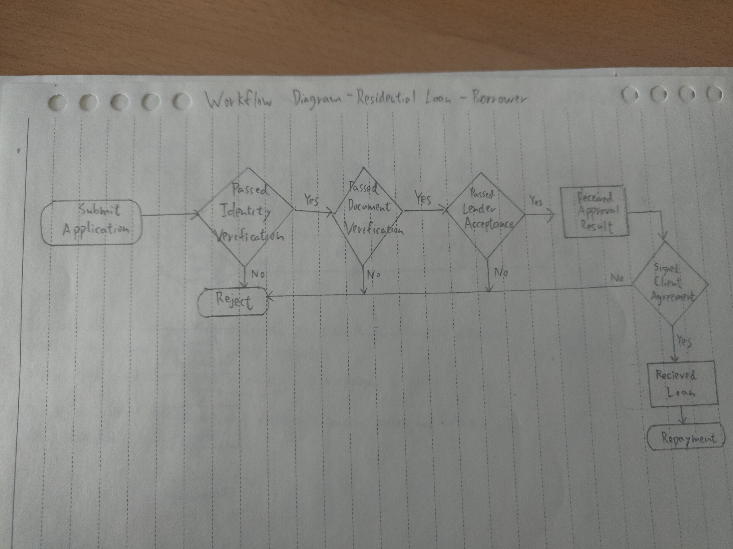
Borrower journey – Residential Loan
Assumption:
Diagram for Happy Flow for borrower only
Loan agreement is attached when borrower receiving approval result
Identity verification is a one-step simply process for borrower, and they gets the result instantly
In happy flow, document verification and lender acceptance were completed by system in real-time. Borrower gets the results of each process in a very short period. Waiting period ignorable.
Client agreement is digitally signed through portal in real-time.
Portal had automated loan disbursement process for happy flow borrower.

Slide 8
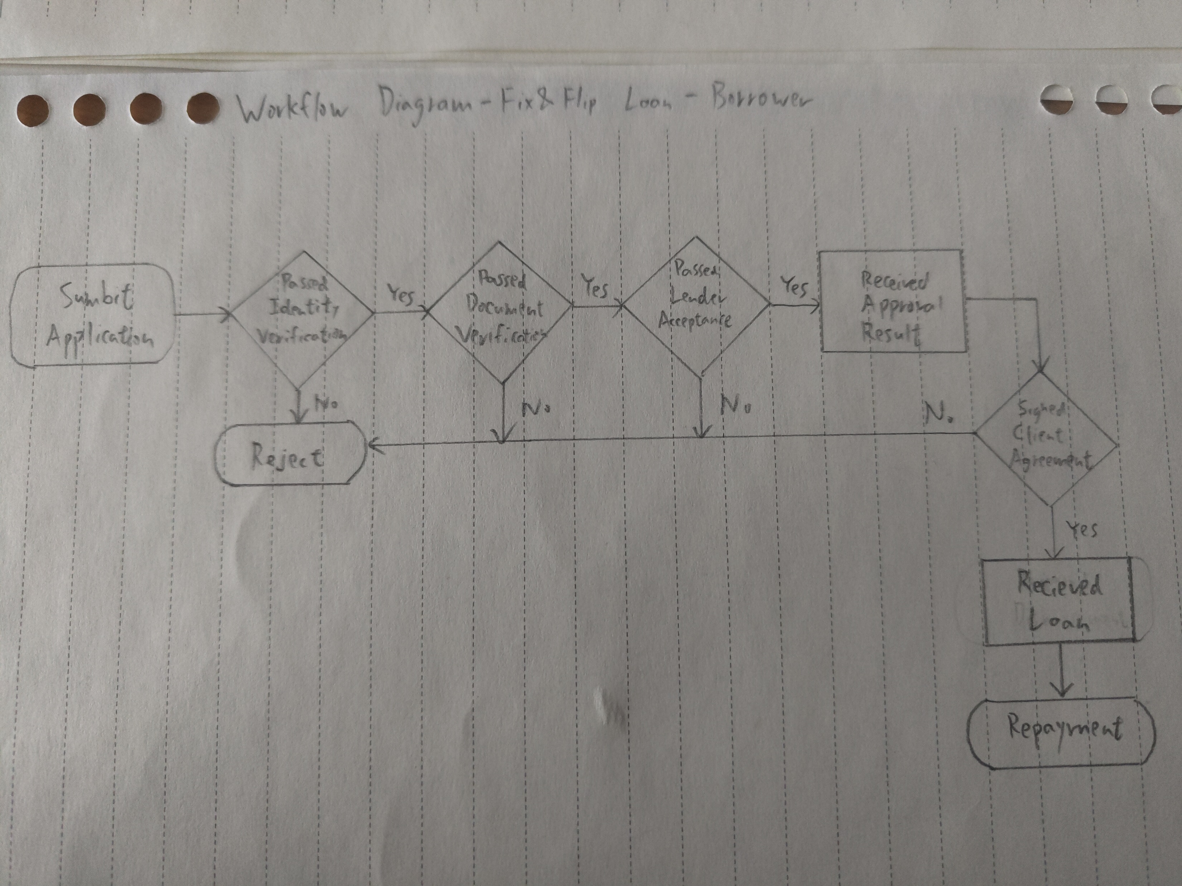
Borrower journey – Fix & Flip Loan
Assumption:
Same approval process with Residential Loan in happy flow (Fix & Flip Loans) for borrower
Loan agreement is attached when borrower receiving approval result
Identity verification is a one-step simply process for borrower, and they gets the result instantly
In happy flow, document verification and lender acceptance were completed by system in real-time. Borrower gets the results of each process in a very short period. Waiting period ignorable.
Client agreement is digitally signed through portal in real-time.
Portal had automated loan disbursement process for happy flow borrower.
Remarks:
Main differences in Fix & Flip loans when compared to residential loans:
Document submission requirement is different: renovation quotation and schedule plan are needed
Disbursement process might split into stages instead of one-time
Higher interest rate
Shorter tenor

Slide 9
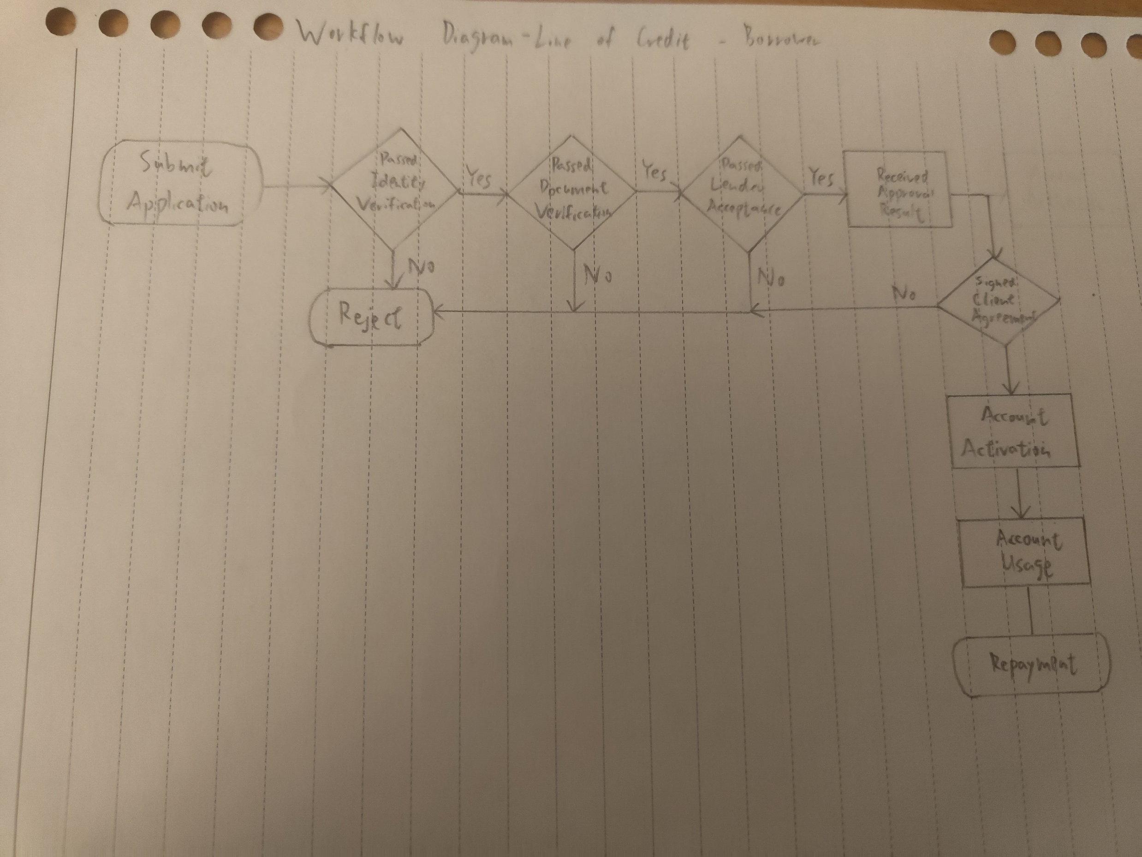
Borrower journey – Line of Credit
Assumption:
Same approval process with Residential, Fix & Flip Loans in happy flow (Line of Credit) for borrower
Loan agreement is attached when borrower receiving approval result
Identity verification is a one-step simply process for borrower, and they gets the result instantly
In happy flow, document verification and lender acceptance were completed by system in real-time. Borrower gets the results of each process in a very short period. Waiting period ignorable.
Client agreement is digitally signed through portal in real-time.
Portal had automated loan disbursement process for happy flow borrower.
Lender have full decision in reviewing client account status and renewal for client agreement
Client won’t actively asking for account renewal/ closure
Remarks:
Main differences between Line of Credit and the other two types of loans:
No disbursement process. If no account usage, no repayment process.
Line of credit products can have short or long duration with client, depending on the specific product features.
Detailed workflows for different line of credit products may be different

Slide 10
Minimal Viable Product
Mock-up screens for borrower workflow:
Design by using Canva resources:
https://www.canva.com/design/DAF6Yt1VP_o/hqxiDU9a1EXXIXzPJiczuQ/edit?utm_content=DAF6Yt1VP_o&utm_campaign=designshare&utm_medium=link2&utm_source=sharebutton
Assumption:
System requirements on 3 types of product are universal, minimal adjustment needed for facilitating all use cases.
Details in application form, declaration, consent, agreement, product information, dashboards are to-be-confirm.
Mock-up screen is the happy flow of borrower journey in residential loan application only.

Slide 11
Q2 Workflow
You're a Business Analyst at Mortgage Automator and you've been assigned to a project to optimize a critical workflow. In your first few weeks, we discovered that multiple lenders on our platform have been experiencing delays, leading to increased turnaround times for approvals and funding.
Thinking Process
I will start by questioning:
What is the problem? Can I define them?
What is the workflow? What is the roles involved?
Where can I get information to help me analyzing the root cause? Who should I look for to get those info?
My approach involves 5 steps:
First, understanding how the business and platform operate.
Next, gathering all relevant platform details.
Then, breaking down issues into manageable parts and defining project goals.
Following this, I collaborate closely with stakeholders, create a clear delivery plan,
and seek budget approval.
Finally, kickstart the system enhancement project.

Slide 12
Q2
Task 1 - How would you approach this situation?
My full answer to question 2 task 1:
To address any problem or enhancement opportunity, my initial steps involve a comprehensive questioning process. I start by identifying the problem and determining if it can be clearly defined. Understanding the workflow and roles involved is crucial, prompting inquiries into how the business and platform operate.
To analyze the root cause and gather relevant information, I seek input from key stakeholders and identify sources such as system documentation, previous project records, and interviews with users. This questioning phase helps me form a solid foundation for the subsequent steps.
My approach comprises five key steps.
Firstly, I focus on understanding the operations of both the business and platform. This is followed by gathering all relevant details about the platform. The third step involves breaking down identified issues into manageable parts and defining specific project goals. Subsequently, I collaborate closely with stakeholders to create a clear delivery plan, seek budget approval, and ultimately kickstart the system enhancement project.

Slide 13
Q2
Task 2- Can you outline the steps you would take, any key factors or actions you would take?
My full answer to question 2 task 2:
I begin the enhancement process by gathering comprehensive information about the platform, including performance metrics, user expectations, business workflows, and the roles involved. This data is sourced from stakeholders, system documentation, previous projects, database records, interviews with users, and internet research.
The next step involves identifying performance issues by questioning delays and understanding the differences between 'delays' and 'normal' in platform operations. Collaborating with project managers, product managers, and users, we define the duration differences and break down problems into minimal unit processes. Through this analysis, we estimate durations, compare them with historical data, and determine whether the issues stem from manual or system processes. Solutions are then crafted, such as organizing platform training sessions for manual processes or collaborating with technical leads to identify tools or technologies for system processes. Costs, manpower, and time are evaluated with project and product managers, considering various options and their pros and cons.
Once the solutions are agreed upon, the project is initiated. (One possible solution is implementing Optical Character Recognition(OCR) technology into the business process. This finding is inspired by market research.) I present the possible options to stakeholders, ensuring mutual consent on the project's direction, budget, and timeline. The project is kicked off with detailed documentation, collaboration with the technical team to ensure quality deliverables, and planning with the project manager for resources, testing, and launch. Throughout the project, I prioritize minimizing business effects on users during system deployment and maintain continuous communication between users and technical teams regarding product enhancements.
In summary, my approach involves six key steps:
Understanding the platform and workflow,
Identifying problems,
Building solutions,
Initiating the project,
Contributing to its progress,
Closing the project.
To ensure efficiency and transparency, I keep detailed records, track development progress closely, and communicate any changes transparently to stakeholders.

Slide 14
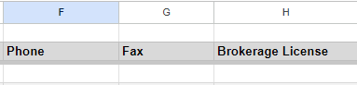
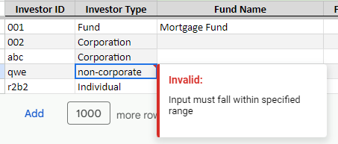
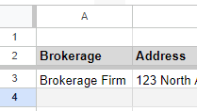
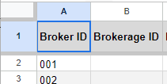
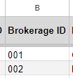
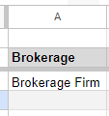
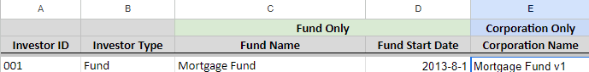
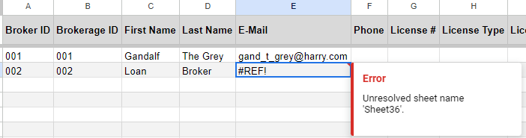
Q3 Data Analysis
In summary, the types of error can be categorized into 6:
‘Missing Value’, example: Refers to picture A
Worksheet “Brokerage” > Row 3 > Columns (F, G, H) title ”phone”, ”fax”, “brokerage license”
‘Data Format Issue’, example: Refers to picture B
Worksheet “Investor Profiles” > Row 6 > Column ( B) title “Investor Type”
‘Worksheet Structural Problem’, example: Refers to picture C
Worksheet “Brokerage” > Column ( A) title “ID” is missing (Please refers to Import Template)
‘Data Not Align Between Worksheets’, example: Refers to picture D
Worksheet “Broker” > Row 2, 3 > Column ( A) title “Broker ID” with input “001” and “002”,
corresponding Broker ID with details not found in worksheet “Brokerage”
‘Redundant Data’, example: Refers to picture E
Worksheet “Investor Profiles” > Row 3 > Column E title “Corporation Name”
‘Incorrect Input’, example: Refers to picture F
Worksheet “Broker” > Row 3 > Column E title “E-Mail”
Input is not in expected structure
P.S.: List of found errors for first 20 rows were recorded in excel file “Data analysis-screening result record”
Assumption: Questionable data such as abnormal loan amount, broker fees, funding date is excluded as they might not be an error
Picture A
Picture B
Picture C
Import Template
Picture D
Picture E
Picture F

Slide 15
Q3 Data Analysis
List of found errors for first 20 rows were recorded in excel file “Data analysis-screening result record”
Assumptions:
Questionable data such as abnormal loan amount, broker fees, funding date not an issue in data migration
The sample of the first 20 rows of data can represent most of the error cases in the whole datasets
Dataset are balanced, errors are normally distributed
Excel formula, source reference are not expected from the input data
Excessive data, missing data, data format and other error types are equally important as they all results in migration fail, no prioritization on critical level of error is needed(except cross-worksheet errors)
Client had experienced in import error handling, able to investigate and fix their data issues independently given specific data issues are known

Slide 16
Q3 Data Analysis
Task 2 - Help structure an email back to the client, asking them to please correct their mistakes, so we don’t have to take on the workload of cleaning up their data.
Email Title: Welcome Aboard! Important Data Migration Details
Dear Mr. Anderson,
Hope you're doing well! We're excited to have you on board and start working together in this new year.
Thank you for promptly submitting the import template. We're eager to help you in getting familiar with the data import process.
Our team checked the template you sent, and we noticed a few things that may need attention to ensure a smooth process. Here are a couple of examples:
Missing Value:
In the "Brokerage" sheet, the cells in row 3, columns (F, G, H) with the title "phone," "fax," and "brokerage license" are missing.
Data Format Issue:
In the "Investor Profiles" sheet, the cell in row 6, column (B) with the title "Investor Type" is not in a valid format.
Worksheet Structural Problem:
In the "Brokerage" sheet, should starting from Column A with the title "ID," the mandatory column maybe accidentally deleted by your team.
Data Not Align Between Worksheets
In the “Broker” sheet, the cells in row 2&3, column A with the title “Broker ID” is not align with the cells in “Brokerage” sheet, row 3&4, column A with the title “ID”
Redundant Data:
In the "Investor Profiles" sheet, the cell in row 3, column (E) with the title "Corporation Name" should be empty as this column is for corporations only.
Incorrect Input:
In the "Broker" sheet, the cell in row 3, column (E) with the title "E-Mail" is not in expected structure.
Questionable Data: (recommend to have check to determine whether it is an error)
In the "Loan Import" sheet, the cells in rows 6 and 7, column (R) with the title "Funding Date" show input from the year 1900.
Fixing these bits will help things run even better. If you have questions or need help, check out the import instructions and the error log I’ve attached in the email.
And feel free to reach out if you're unsure about anything.
We're here to help, and your assistance in fixing these matters will make a huge difference. Thanks for choosing us! We’re excited about working with you.
Warmest regards,
Franco Fan
Business Analyst
(433) 644-9367
Mortgage Automator
Attachments: 1) Import instructions video, 2) Data analysis-error log

